Slide 1

BROKESPLITTER.COM
Group 7
Ron Dumalagan, Himmat Garcha, Michael Lamaze, Shannon Nicole Dinio
Notes:
Shannon, By all of us

Slide 2
Description of our Website
Problem: splitting restaurant bills is a pain
Solution: split the bill evenly, percentage, or based on meal
Example 1: $50 bill, split x ways among x people
Example 2: $400 bill, person X chips in 80%, person Y chips in 20%
Example 3: $100 bill, person X ordered a $60 dish, person Y …
Dropdown to choose split type
Dropdown to specify state (for taxes)
Numerical input textboxes
Tipping + Taxes included
Notes:
Himmat

Slide 3
Rough Layout Slide
Broke Splitter
Split Type:
State
Even
NJ
By Meal
By %
Submit
Notes:
Mike

Slide 4
Rough Layout Slide Pt 2
Broke Splitter
Item Name
Price
Person
Add Person
Burger
$10
Bob
Add Item
Hot Dog
$5
Alice
Add Tip
Sub-Total:
$15
Submit
Tip
$0.00
Tax
$0.99
Grand Total
$15.99
Notes:
Mike

Slide 5
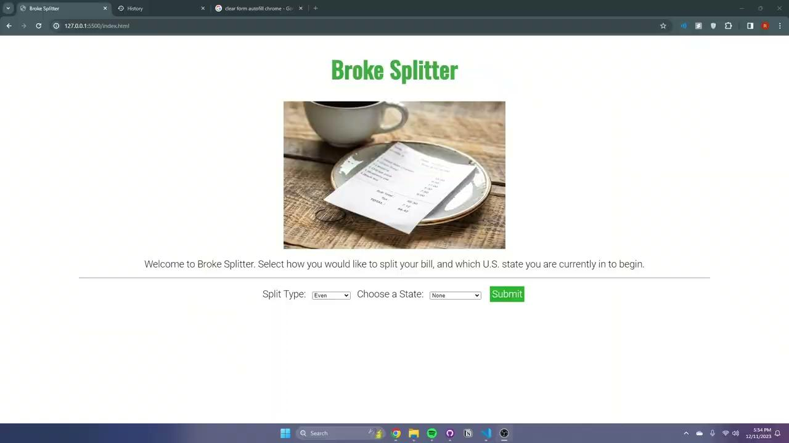
Video
Notes:
Ron

Slide 6
Live Demo
Notes:
Ron

Slide 7
Uses/Choices of HTML elements
<button>: creates a javascript variable which in our case adds a new element which in our case adds either, a new person, item, new cost, etc
<table>: Creates data sheet which all elements and their values are stored and displayed
<input> id=“” name=“” type=“”: creates the drop down menu for the buttons and sets there attributes so that the button and table know what to run.
<select>: used to create a drop-down list
Notes:
Himmat

Slide 8
DOM Diagram
<html>
<head>
<body>
<title>
<h1>
<p>
<input>
<table>
<button>
<image>
<header>
<attribute>
<text>
<link text>
Notes:
Himmat

Slide 9
Use/Choices of JS
Dynamic formatting
Buttons that show/hide elements on the page when clicked
Buttons that add/delete additional rows to tables
Notes:
Ron

Slide 10
Use/Choices of CSS
<meta name="viewport" content="width=device-width, initial-scale=1.0">
This meta tag sets the viewport width to the device width and ensures that the initial scale is 1.0.
<link rel="stylesheet" href="./styles/styles.css" />
<link rel="stylesheet" href="./styles/mobile.css" media="screen and (max-width:480px)" />
<link rel="stylesheet" href="./styles/tablet.css" media="screen and (min-width:481px) and (max-width:768px)" />
<link rel="stylesheet" href="./styles/desktop.css" media="screen and (min-width: 769px)"/>
External stylesheets are linked to the HTML file, instead of having all the rules in a single file, we can put them in separate files and add media queries to <link> elements
Notes:
Shannon
mobile.css: This stylesheet is applied only when the screen width is up to 480 pixels.
tablet.css: This stylesheet is applied for screen widths between 481 pixels and 768 pixels.
desktop.css: This stylesheet is applied for screen widths greater than or equal to 769 pixels.

Slide 11
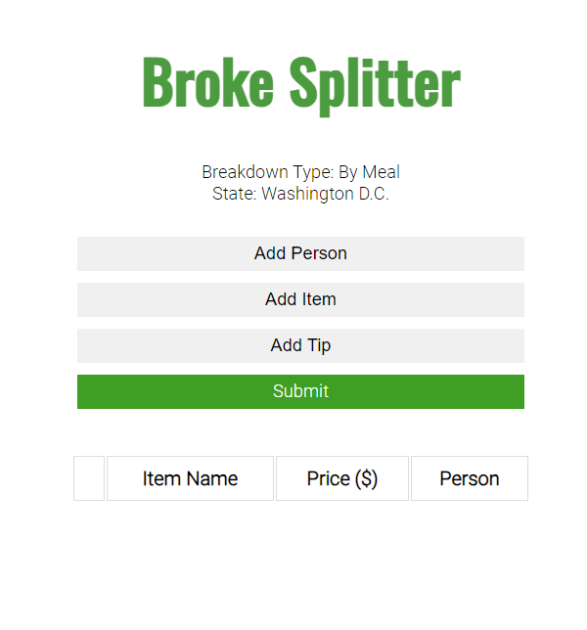
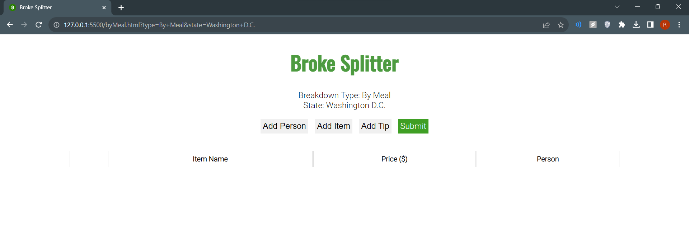
Mobile and Tablet
Desktop
Notes:
Shannon

Slide 12
Contributions & GitHub
Home page - Shannon
CSS - Michael
By Meal Split scripts- Ron
Percentage + Even Split scripts - Himmat
GitHub Link
Google Chrome (Will not work as domain need to be accessible online)
Hosted on Live Server(http://localhost:3000/)
Notes:
Michael

Slide 13
Thank you!

